Slide 1
ENCS 282 Presentation APP: Sharing of agricultural machinery
Author: Yifan Yang
Student id:40038814

Slide 2
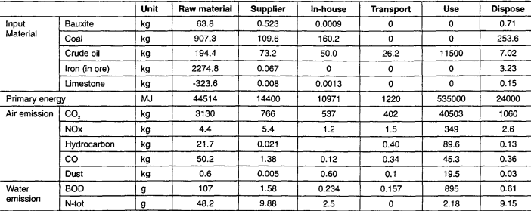
Problem : The huge energy and material to produce agricultural machine
Life cycle assessment of tractor[1]

Slide 3
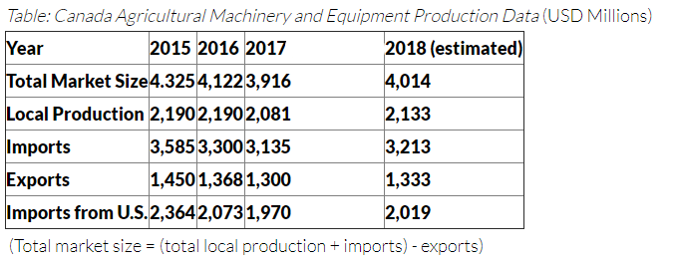
Business model in developed country
[2]
Problem : People still produce and import agricultural machine when the market is saturated.
Reason : Mainly because old ones are scrapped. And farmers still need to use agricultural machine.
Solution : Rent existing usable one instead of producing new one

Slide 4
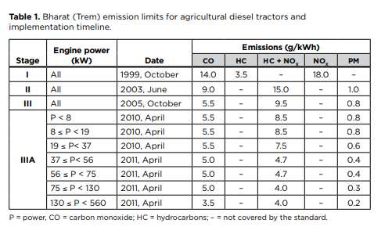
Business model in developing country
[3]
Problem : Farmers cannot afford agricultural machine. Old-typed and unqualified agricultural machine
Solution :Offer unified and qualified agricultural machine

Slide 5
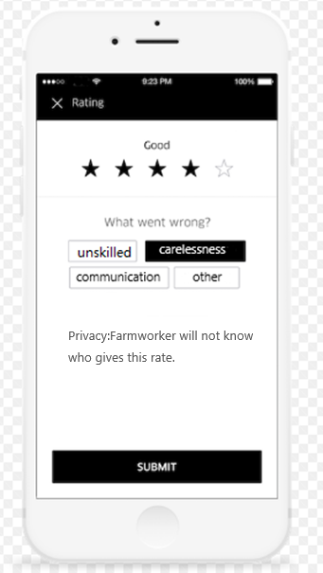
Designated Driving Service
Problem : For single farm, unskilled farmworker use the same resource to do less thing
Solution: The designated driving service can help you find skilled farmworker with rating system
Anonymous Rating System[4]

Slide 6
Applicant Eligibility
Problem produced by sharing agricultural machine: The agricultural machine you rent out is expensive, others may do damage to your agricultural machine unintentionally.
Solution : Strict applicant eligibility
If you want to rent agricultural machine,
you have to provide:
1.Driver license for agricultural machine
2.Cash pledge
3.Insurance fee

Slide 7
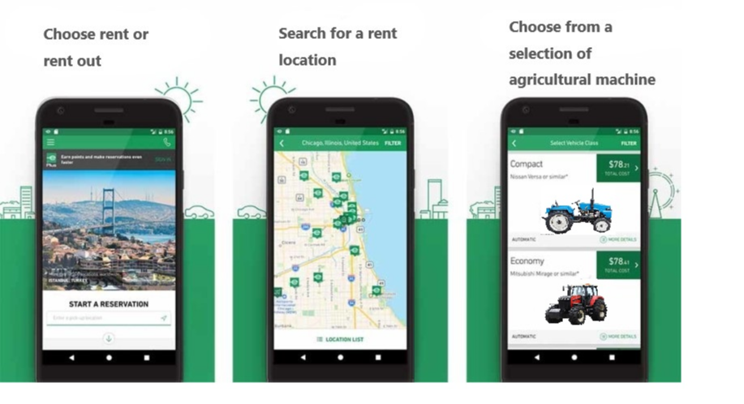
Operation Interface
App screenshot[5-6]

Slide 8
References
[1] J.Lee, H.Cho, et al. (2000). ”Life cycle assessment of tractors”.[online]. Available at: https://link.springer.com/article/10.1007/BF02979361 [Accessed 5 June. 2018]
[2] V.Oujegov.(2017).”Canada - Agricultural Machinery and Equipment” [online]. Available at :https://www.export.gov/article?id=Canada-Agricultural-Machinery-and-Equipment [Accessed 5 June. 2018]
[3] Z.Shao.(2016). “An emissions inventory for agricultural tractors and construction equipment in India”[online]. Available at :https://www.theicct.org/sites/default/files/publications/India%20Non-road%20Emissions%20Inventory%20Working%20Paper_vF.pdf [Accessed 5 June. 2018]
[4] E.McNutt.(2017).” Uber Is Changing up Its Passenger and Driver Rating System” [online]. Available at : https://thepointsguy.com/2017/04/uber-changing-rating-system/ [Accessed 5 June. 2018]
[5]J.Hindy.(2017).” 10 best car rental apps for Android” [online]. Available at : https://www.androidauthority.com/best-car-rental-apps-android-784387/ [Accessed 5 June. 2018]
[6]” BELARUS MTZ 82.1” [online]. Available at : https://www.mojauto.rs/polovni-poljoprivredna/2562740_BELARUS_MTZ-82-1_2017_god/?cena=high [Accessed 5 June. 2018]

